Slide 1
Chapter Eight
SET, DICTIONARy, default dictionary, comprehension, data structures, modules

Slide 2
Sets

Slide 3
Sets
A set is a container that stores a collection of unique values.
A set is mutable, so unique data can be added or removed from it.
Unlike a list, the elements or members of the set are not stored in any particular order and cannot be accessed by position.
Some set operations are the same as the math operations performed on sets.
Because sets do not need to maintain a particular order, set operations are faster than the equivalent list operations.

Slide 4
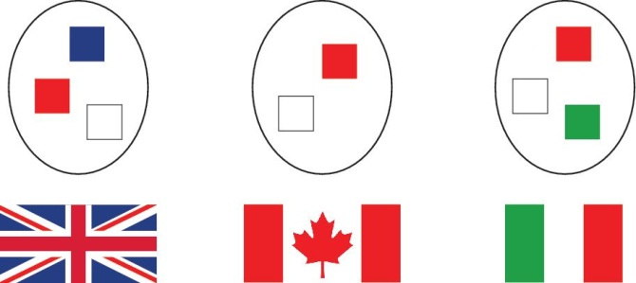
Example Set
This set contains three sets of colors––the colors of the British, Canadian, and Italian flags
In each set, the order does not matter, and the colors are not duplicated in any one of the sets

Slide 5
Creating Sets (1)
To create a set with initial elements, we can specify the elements enclosed in braces, just like in math:
cast = { "Luigi", "Gumbys", "Spiny" }
Alternatively, we can use the set() function to convert any sequence into a set:
names = ["Luigi", "Gumbys", "Spiny"]
cast = set(names)
We cannot use {} to make an empty set in Python
Instead, use the set() function with no arguments:
cast = set()

Slide 6
Creating Sets (2)
We can also use set comprehension when we need to create a new set by adding one data value at a time to a set
myList = [2,3,4,3,2,5,6,2]
mySet = {num for num in myList if num % 2 == 0}
# mySet is {2, 4, 6}

Slide 7
Accessing Set Elements
Because sets are unordered, we cannot access the elements of a set by index.
We use a for loop to iterate over the individual elements:
print("The cast of characters includes:")
for character in cast :
print(character)
Note that the order in which the elements of the set are visited depends on how they are stored internally.
For example, the previous loop above displays the following:
The cast of characters includes:
Gumbys
Spiny
Luigi
The order of the elements in the output is different from the order in which the set was created.

Slide 8
Built-in Functions for Sets

Slide 9
The len Function
As with any container, we can use the len function to obtain the number of elements in a set:
numberOfCharacters = len(cast)

Slide 10
Displaying Sets In Sorted Order
Because elements in a set are not in any particular order, it’s common to use the sorted function with a set to get all elements in a sorted order.
sorted returns a list (not a set) of the elements.
The following loop prints the set called cast in sorted order:
for actor in sorted(cast) :
print(actor)

Slide 11
Set Operator and Methods

Slide 12
The in Operator
To determine whether an element is contained in the set, use the in operator or its inverse, the not in operator:
if "Luigi" in cast :
print("Luigi is a character in the show.")
else :
print("Luigi is not a character in the show.")

Slide 13
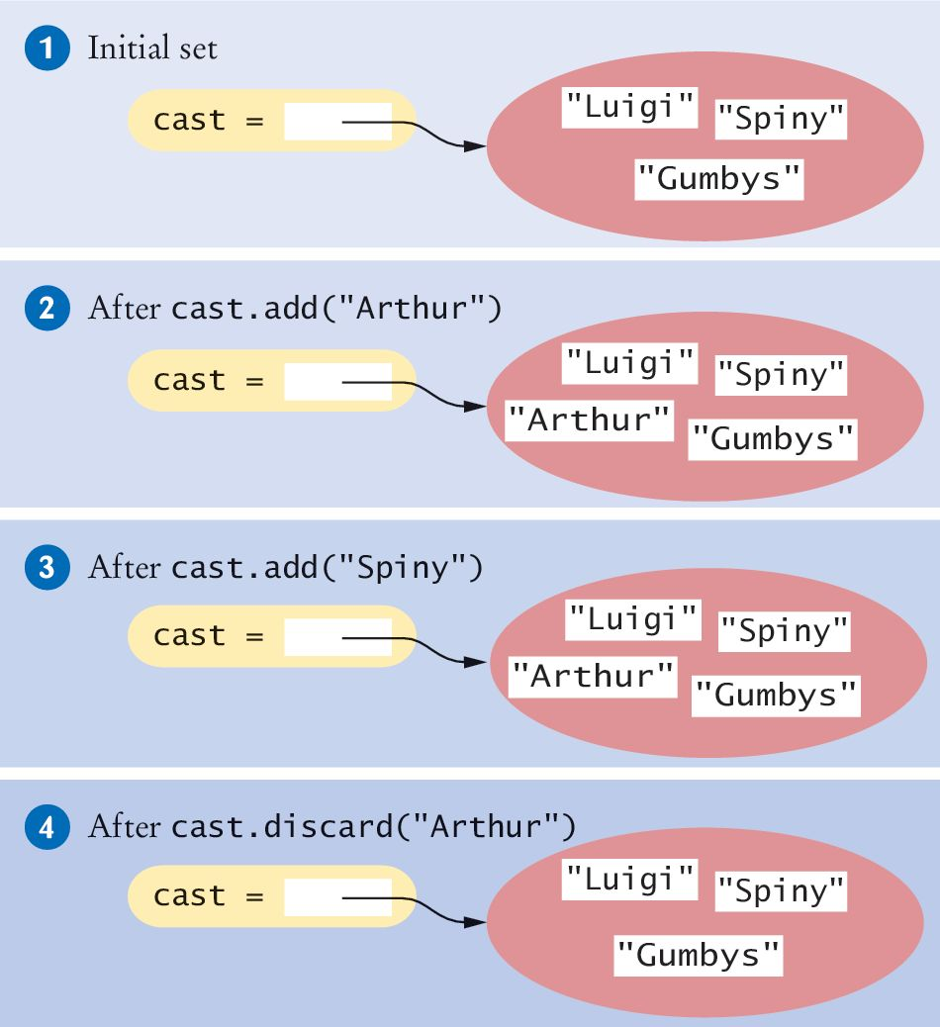
Adding Elements: add
We can add elements by using the add method:
cast = set(["Luigi", "Gumbys", "Spiny"]) #1
cast.add("Arthur") #2
cast.add("Spiny") #3
Arthur is not in the set, so it is added to the set and the size of the set is increased by one.
Spiny is already in the set, so there is no effect on the set.

Slide 14
Removing Elements: discard
The discard method removes an element if the element exists:
cast.discard("Arthur") #4
It has no effect if the given element is not a member of the set:
cast.discard("The Colonel") # Has no effect

Slide 15
Removing Elements: remove
The remove method, on the other hand, removes an element if it exists, but raises an exception if the given element is not a member of the set:
cast.remove("The Colonel") # Raises an exception

Slide 16
Removing Elements: clear
The clear method removes all elements of a set, leaving the empty set:
cast.clear() # cast now has size 0

Slide 17
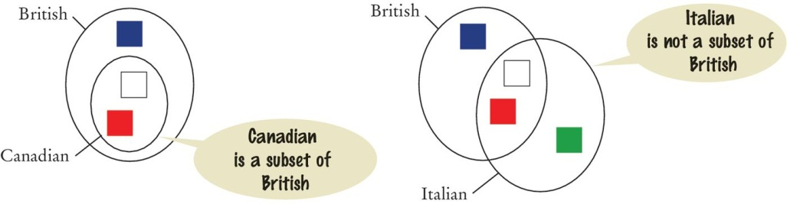
Subsets
A set is a subset of another set if and only if every element of the first set is also an element of the second set
In the image below, the Canadian flag colors are a subset of the British colors
The Italian flag colors are not.

Slide 18
Check for subset: issubset
The issubset method returns True or False to report whether one set is a subset of another:
canadian = { "Red", "White" }
british = { "Red", "Blue", "White" }
italian = { "Red", "White", "Green" }
# True
if canadian.issubset(british) :
print("All Canadian flag colors occur in the British flag.")
# True
if not italian.issubset(british) :
print("At least one of the colors in the Italian flag does
not.")

Slide 19
Set Equality / Inequality
We test set equality with the == and != operators
Two sets are equal if they have exactly the same elements.
french = { "Red", "White", "Blue" }
if british == french :
print("The British and French flags use the same colors.")

Slide 20
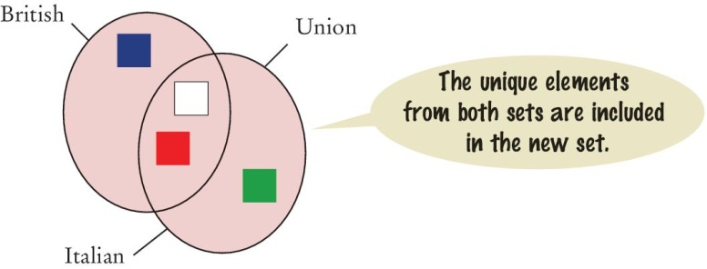
Union: union or |
The union of two sets is a new set that contains all of the elements from both sets, with duplicates removed.
inBoth = british.union(italian)
# or:
inBoth = british | italian
# inBoth is {"Blue", "Green", "White", "Red"}
Both the British and Italian sets contain the colors Red and White, but the union is a set and therefore contains only one instance of each color.

Slide 21
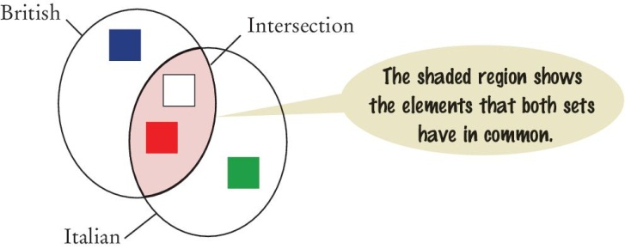
Intersection: intersection or &
The intersection of two sets is a new set that contains all of the elements that both sets have in common.
inCommon = british.intersection(italian)
# or:
inCommon = british & italian
# inCommon is {"White", "Red"}

Slide 22
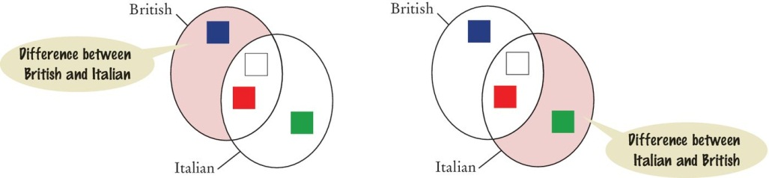
Difference: difference or -
The difference of two sets is a new set that contains those elements in the first set that are not in the second set.
onlyItalian = italian.difference(british))
# or
onlyItalian = italian - british
# onlyItalian is {'Green'}

Slide 23
Set Application

Slide 24
Typical Set Usage
Problem statement:
We want to count the number of unique words in a text document
“Mary had a little lamb” has 57 unique words
Solution:
Our task is to write a program that reads in a text document and determines the number of unique words in the document.
The simplest solution is to read each word from the file and add it to the set
Because a set cannot contain duplicates, the add method will prevent a word that was encountered earlier from being added to the set.
After we process every word in the document the size of the set will be the number of unique words contained in the document.

Slide 25
Advanced Topic with Sets

Slide 26
Set Comprehension
Just like with list comprehension, Python has set comprehension for when we need to create a set by adding one element at a time.
The format for a set comprehension is similar to a list comprehension, except that we use { } for sets, instead of [ ] for lists.
Example: Read integers from a file and store only one copy of each integer
{expr(elem) for elem in iterable if condition(elem)}
with open("input.txt") as infile:
nums = {int(n) for n in infile}
# nums is a set of unique integers in input.txt

Slide 27
Dictionaries

Slide 28
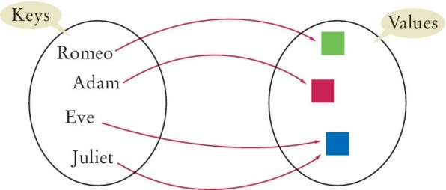
Dictionaries
A dictionary is a container that keeps associations between pairs of data: keys and values
Every key in the dictionary has an associated value, they make up the key:value pair.
Keys must be unique and immutable. Values can be mutable and there can be duplicate values.
Just like with sets, there is no particular order for the key:value pairs in the dictionary.
Example (the mapping between the key and value is indicated by an arrow):

Slide 29
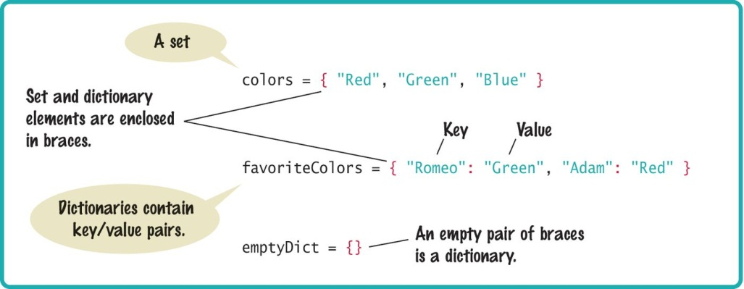
Syntax: Sets and Dictionaries

Slide 30
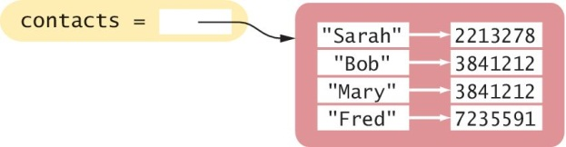
Creating Dictionaries (1)
Suppose we need to write a program that looks up the phone number for a person in a mobile phone’s contact list.
The contact list can be a dictionary where the names are keys and the phone numbers are values.
We choose the names for the keys because the names are used to search the dictionary.
contacts = { "Fred": 7235591, "Mary": 3841212, "Bob": 3841212, "Sarah": 2213278 }

Slide 31
Creating Dictionaries (2)
We can also create a dictionary from another dictionary with the dict function:
Because a dictionary is made of pairs of data, we can also create a dictionary from 2 lists or 2 tuples with the zip function:
The zip function combines corresponding values of the 2 lists into pairs, which become the key:value pairs of the new dictionary.
The first list or tuple make up the keys, the second list or tuple become the corresponding values.
newContacts = dict(contacts)
letters = ['a', 'b', 'c']
numbers = [1, 2, 3]
mydict = dict(zip(letters, numbers))
# mydict is {'c': 3, 'a': 1, 'b': 2}
mydict = dict(zip(numbers, letters))
# mydict is {1: 'a', 2: 'b', 3: 'c'}

Slide 32
Creating Dictionaries (3)
If we have pairs of corresponding data, we can also create a dictionary from the pairs of data.
mylist = [('A',65), ('B',66), ('C',67)]
# mylist is a list of pairs of data
mydict = dict(myList)
# mydict is {'A':65,'B':66,'C':67}

Slide 33
Dictionary Operators

Slide 34
Accessing Dictionary Values with [ ]
The [] operator is used to return the value associated with a key.
print("Fred's number is", contacts["Fred"])
# print: 7235591.
Note that the dictionary is not a sequence-type container like a list.
We cannot access the items by index
A value can only be accessed using its associated key
Just as with an invalid index, using a non-existing key to access a dictionary will result in an exception.

Slide 35
Checking Membership: in
To check whether a key is present in the dictionary, use the in (or not in) operator:
if "John" in contacts :
print("John's number is", contacts["John"])
else :
print("John is not in my contact list.")

Slide 36
Working with Dictionaries

Slide 37
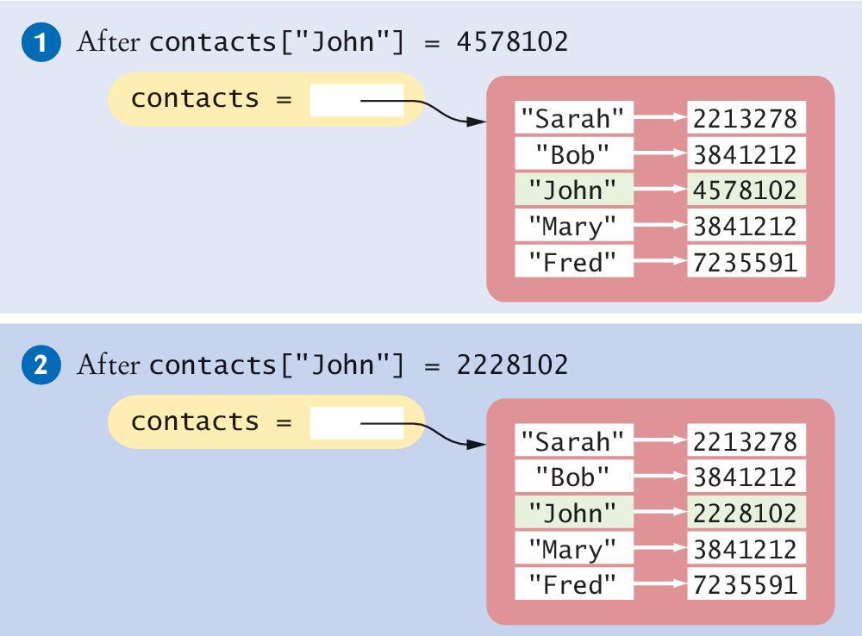
Adding/Modifying Items
We can add a new item using the [] operator, just like would with a list
contacts["John"] = 4578102 #1
To modify the value associated with a given key, set a new value using the [] operator on an existing key:
contacts["John"] = 2228102 #2

Slide 38
Adding New Items Dynamically
Sometime we may need to create an empty dictionary and add data one by one, such as when we read data in from file or from the user iniput.
First create an empty dictionary:
favoriteColors = {}
Then add new items as we read the data in:
favoriteColors["Juliet"] = "Blue"
favoriteColors["Adam"] = "Red"
favoriteColors["Eve"] = "Blue"
favoriteColors["Romeo"] = "Green"

Slide 39
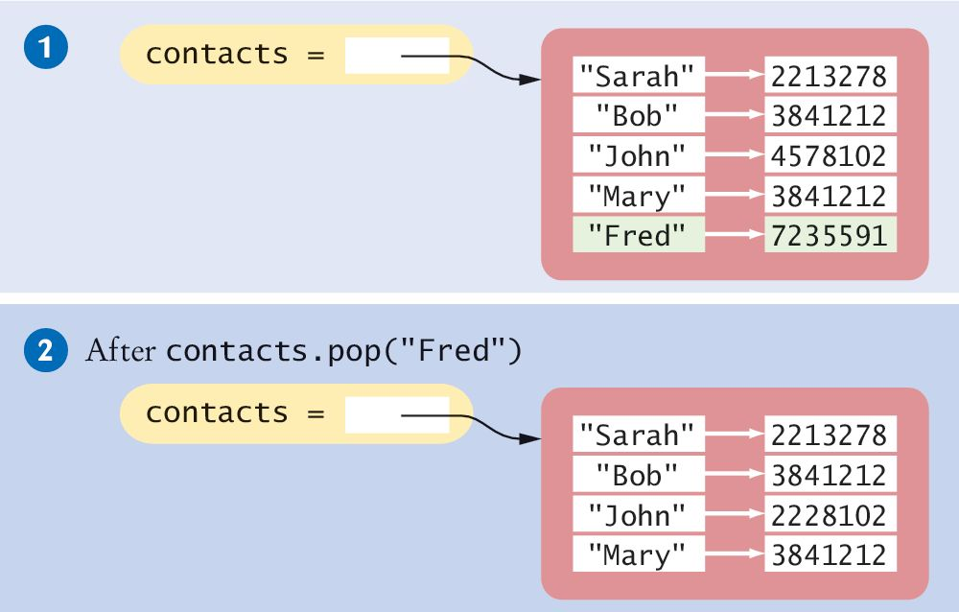
Removing Items (1)
To remove an item from a dictionary, call the pop method with the key as the argument:
contacts = {"Fred": 7235591, "Mary": 3841212,
"John": 3841212 "Bob": 3841212,
"Sarah": 2213278}
This removes the entire item, both the key and its associated value.
contacts.pop("Fred")

Slide 40
Removing Items (2)
The pop method returns the value of the item being removed, which we can store in a variable:
fredsNumber = contacts.pop("Fred")
If the key is not in the dictionary, the pop method raises a KeyError exception

Slide 41
Traversing a Dictionary (1)
We can iterate over the individual keys in a dictionary using a for loop:
for key in contacts :
print(key)
The printed keys will not in any particular order because the dictionary stores key:value pairs based on a hashing function, which makes data look up in a dictionary very fast but puts data in random order.
To iterate through the keys in sorted order, we can use the sorted function as part of the for loop:
for key in sorted(contacts) :
print(key, contacts[key]))

Slide 42
Traversing a Dictionary (2)
We can also iterate over the items in a dictionary using the items method, which is more efficient than iterating over the keys and then looking up the value of each key.
The items method returns a sequence of tuples that are the key:value pairs in the dictionary:
or
for item in contacts.items() :
print(item[0], item[1])
for k,v in contacts.items() :
print(k, v)

Slide 43
Dictionary Values
To get all values in a dictionary, we use the values method
for val in contacts.values():
print(val)
Alternatively we can get all values in a list by converting the output of the values method into a list:
We can create a list of keys the same way by using the keys() method.
allValues = list(contacts.values())

Slide 44
Default Values
Recall that if we try to fetch the value of a non-existing key "Fred"
then we get a KeyError exception.
Instead of getting an exception, we often want to have a default value if a key is not present.
In this case it’s better to call the get method and pass the key and a default value.
If "Fred" is a key in the dictionary, get returns the number for "Fred".
If "Fred" is not a key in the dictionary, get returns the default 411.
number = contacts["Fred "]
number = contacts.get("Fred", 411)

Slide 45
Default Dictionaries
Instead of using get with a default value, we can also create a default dictionary instead of the built-in dictionary.
A default dictionary is in the collections module, just like the named tuple is in the collections module.
When we create a default dictionary, we give it the data type of the values that will be stored in the dictionary.
If we access the default dictionary with a non-existing key, the dictionary will return a default value that’s appropriate for the data type
int: default is 0
float: default is 0.0
str: default is empty string
iterable: default is the empty iterable
myDefaultDict = collections.defaultdict(data_type)

Slide 46
Default Dictionary Example
We want to have a count of each letter that appears in the string myStr
1. Import the collection module
2. Define the default dictionary
The data type int means that the default value will be 0.
3. Use the dictionary to count letters in myStr
The first occurrence of the letter ‘t’: letterCount[‘t’] starts off at the default 0. Adding 1 means letterCount[‘t’] becomes 1.
The next occurrence of the letter ‘t’: letterCount[‘t’] + 1 means letterCount[‘t’] becomes 2.
We count up with every ‘t’ that we find in myStr.
import collections
letterCount = collections.defaultdict(int)
for char in myStr :
letterCount[char] += 1

Slide 47
Advanced Topic for Dictionaries

Slide 48
Dictionary Comprehension (1)
Just like with list and set comprehensions, we can also use dictionary comprehension for when we need to create a dictionary by adding one key:value pair at a time.
Note that both set and dictionary comprehensions use the { }. The difference between them is that a dictionary is created if there is a key:value pair to be added to the container.
Example: Create an ASCII value : letter association for the first 10 uppercase letters
{key:expr(key) for key in iterable if condition(key)}
lettersDict = {n:chr(n) for n in range(65,75)}
# n is 65,66,67...
# chr(n) is the character corresponding to n
# lettersDict is {65:'A', 66:'B', 67:'C', 68:'D',
69:'E', 70:'F', 71:'G', 72:'H',
73:'I', 74:'J'}

Slide 49
Dictionary Comprehension (2)
Example: double all the values in a dictionary
Example: create a new dictionary out of the D dictionary above, but only when value >= 10
D = {'a':5, 'b':7, 'c':3, 'd':5}
D = {k:2*v for k,v in D.items()}
print(D)
# output: {'c':6, 'a':10, 'd':10, 'b':14}
newD = {k:v for k,v in D.items() if v >= 10 }
print(newD)
# output: {'a': 10, 'd': 10, 'b': 14}

Slide 50
Complex Structures

Slide 51
Complex Structures
We’ve covered the basic containers in Python: list, tuple, set, and dictionary.
In addition to storing multiple basic data types such as int or float, containers can store multiple other containers.
This can help us build complex data structures to organize our data.

Slide 52
Example: A Dictionary of Sets (1)
The index of a book specifies on which pages a particular term occurs.
We want to build a book index from page numbers and terms contained.
Our input file format is page number:term
The output of the program should be a list of terms in alphabetical order followed by the page numbers on which the term occurs, separated by commas, like this:
6:type
7:example
7:index
7:program
8:type
10:example
11:program
20:set
example: 7, 10
index: 7
program: 7, 11
type: 6, 8
set: 20

Slide 53
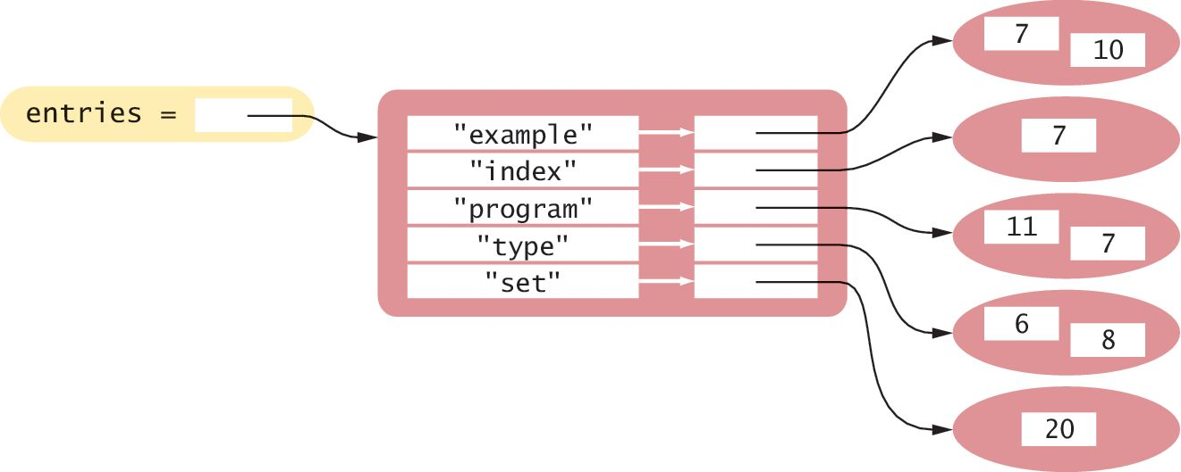
Example: A Dictionary of Sets (2)
A dictionary of sets would be appropriate for this problem
Each key is a term and its corresponding value is a set of the page numbers where it occurs.

Slide 54
Example: A Dictionary of Sets (3)
Why use a dictionary?
The terms need to be unique.
By making each term a dictionary key, there will be only one instance of each term.
The output must show the terms in alphabetical order.
We can iterate over the keys of the dictionary in sorted order.
Why use a set?
Duplicate page numbers for a term should only be included once
By adding each page number to a set, we ensure that no duplicates will be added.

Slide 55
Example: A Dictionary of Lists (1)
A common use of dictionaries in Python is to store a collection of lists in which each list is associated with a unique name or key
For example, we want to store data from a text file that represents the yearly sales of different ice cream flavors in multiple stores of a retail ice cream company.
The format of the input file is
ice cream flavor:store1 sales:store2 sales:store3 sales
vanilla:8580.0:7201.25:8900.0
chocolate:10225.25:9025.0:9505.0
rocky road:6700.1:5012.45:6011.0
strawberry:9285.15:8276.1:8705.0
cookie dough:7901.25:4267.0:7056.5

Slide 56
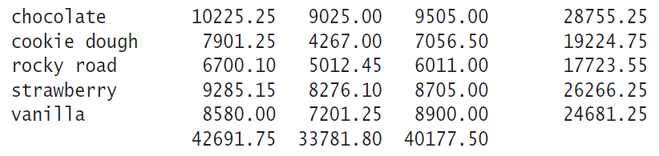
Example: A Dictionary of Lists (2)
The output report should be similar to the following format:
ice cream flavor store1 sale store2 sale store3 sale total sale
and the ice cream flavors are sorted in alphabetical order.

Slide 57
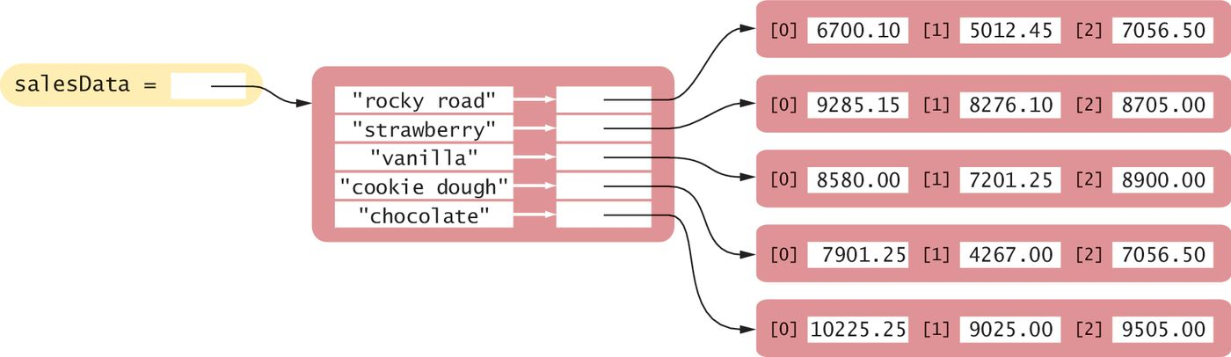
Example: A Dictionary of Lists (3)
With a dictionary of lists, each ice cream flavor is a key in the dictionary
The value for each key is a list that contains the sales, by store, for that flavor of ice cream

Slide 58
More Complex Structures
The previous two examples show us two-dimensional data structures: a dictionary of sets and a dictionary of lists.
Sometime we need more complex structures with three dimensions. For example: a dictionary of lists, where each list is a list of tuples.
When working with multi-dimensional data structures, it is a good idea to draw out the structures or use tools that can help us visualize how the data are stored.
Any further than 3 dimensional, then it gets too complex and becomes harder to maintain. At that point, it is better to organize the data into user-defined classes, which automatically group data together.
key1
...
key2
key3
[0]
[1]
...
...
(8,2,5)
(3,8)

Slide 59
Comprehensions for 2D structures
When we need to create a two-dimensional containers by adding one data item at a time, it is possible to use comprehension.
The following is a 2D comprehension to create a list from a table:
The following is a 2D comprehension to create a table from another table:
Example: create a table of positive numbers from an existing table
[expr(item) for row in table for item in row]
[[expr(item) for item in row] for row in table]
table = [[1,-3,5,6], [2,3,-1,9], [2,8,-4,-8]]
positives = [[n for n in row if n>0] for row in table]
print(positives)
# output: [[1, 5, 6], [2, 3, 9], [2, 8]]

Slide 60
Copying Complex Structures
Because a complex data structure is a container of other containers, it is important that we do a deep copy when we want to create a duplicate data structure.
For a deep copy, we use the deepcopy function of the copy module
On the other hand, if we simply want an alias to a complex structure, we can use the assignment operator
import copy
newContainer = copy.deepcopy(originalContainer) # newContainer is a duplicate of originalContainer, # all inner containers are copied
newContainer = originalContainer
# newContainer is an alias or another name for
# originalContainer. No new data structure is created.

Slide 61
Modules
Splitting our programs into pieces

Slide 62
Modules
When we write small programs, we can place all of our code into a single source file.
When our programs get larger or we work in a team, that situation changes.
We will want to structure the code by splitting it into separate source files. Python source files that work together are called modules.

Slide 63
Reasons for Using Modules
Large programs can consist of hundreds of functions that become difficult to manage and debug if they are all in one source file.
By distributing the functions over several source files and grouping related functions together into a module, it becomes easier to test and debug the functions.
The second reason becomes apparent when we work with other programmers in a team.
It would be very difficult for multiple programmers to edit a single source file simultaneously.
The program code is broken up into modules so that each programmer is solely responsible for a unique set of files.

Slide 64
Typical Division Into Modules
Large Python programs typically consist of a driver module and one or more supplemental modules.
The driver module contains the main() function or the first executable statement if no main function is used.
The supplemental modules contain supporting functions and constant variables.

Slide 65
Using Code That are in Modules
To call a function or use a constant variable that is defined in a user defined module, we first import the module in one of the two ways that we import a standard Python module.
Import only the functions or data that we need from the module
To call the printReport function:
However, if a module defines many functions, it is best to use the form:
With this form, we must prepend the name of the module to the function name:
from tabulardata import readData, printReport
printReport(salesData)
import tabulardata
tabulardata.printReport(salesData)

Slide 66
End of Chapter 8 Notes

